Slide 1

Forecasting with Temporal Hierarchies
www.linkedin.com/in/filotas-theodosiou
www.linkedin.com/in/filotas-theodosiou
Filotas Theodosiou
Contact Details:
- filotas.theodosiou@vives.be
- www.linkedin.com/in/filotas-theodosiou

Slide 2
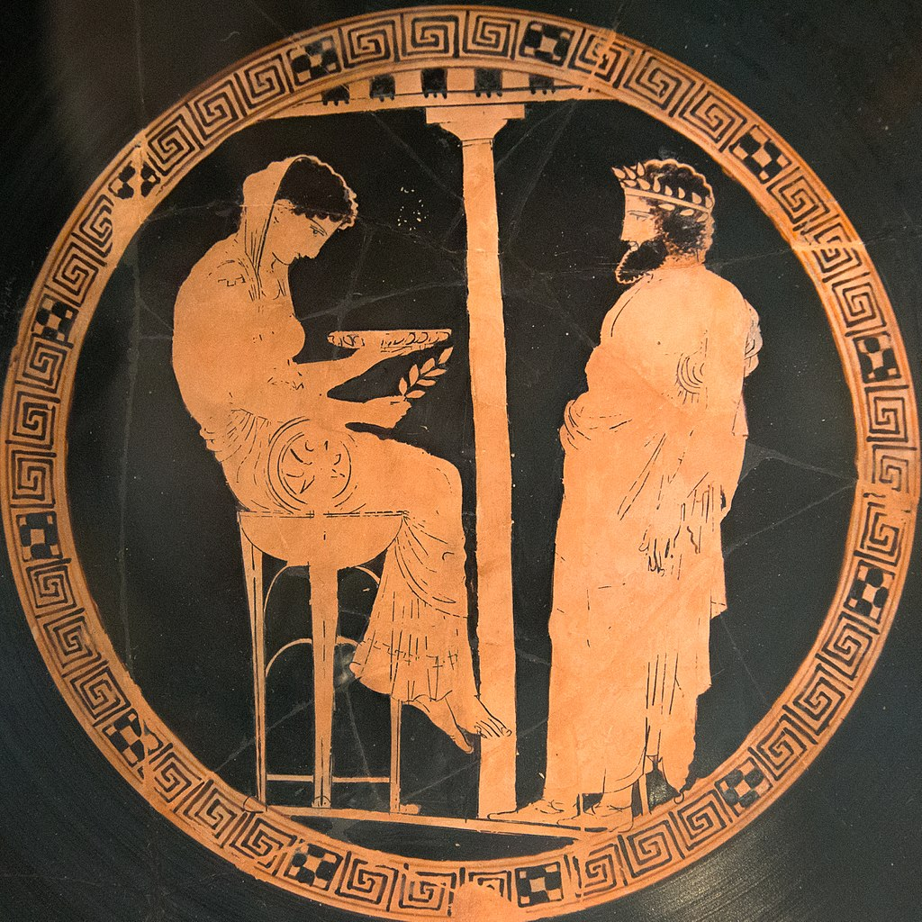
Why do we Forecast?
“Planning is bringing the future into the present so you can do something about it now”
We want to predict the future in order to act now
In that sense: Forecasting is used as a tool to assist in decision making
King Algeus in front of Pythia at the Oracle of Delphi, 440-430 BC
More formally:
Find best action α that minimizes the expected cost depending on the action and the forecast
Examples:
Forecast the weather to optimize agriculture planning
Forecast the number of tourists to prepare summer investments and workforce

Slide 3


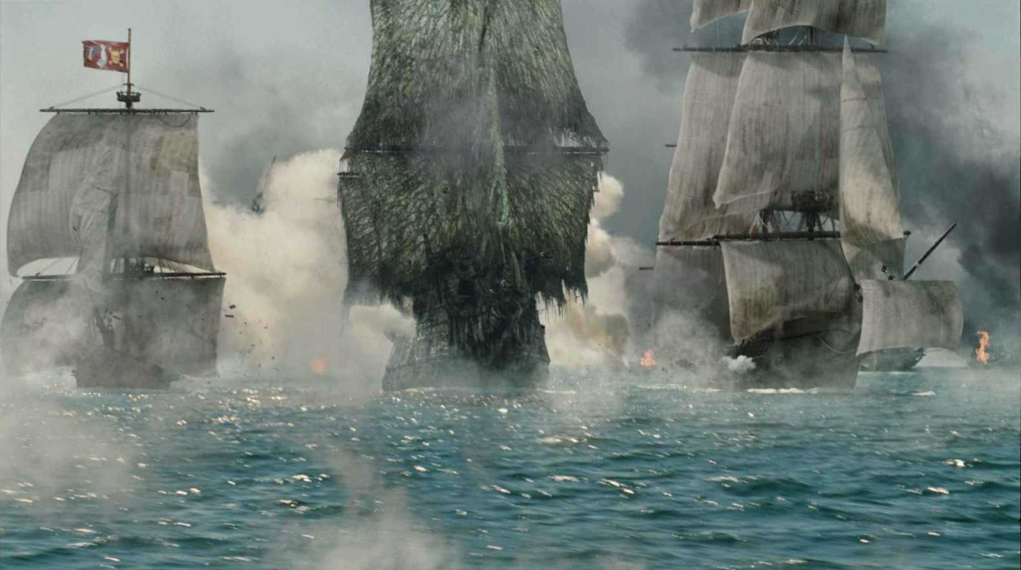
We Forecast to Make a Decision
1. What is the task we are trying to solve?
What is the decision that informs the forecast?
What business problem does the decision trying to solve?
Make a decision
Predict
Solve a Business Task

Slide 4
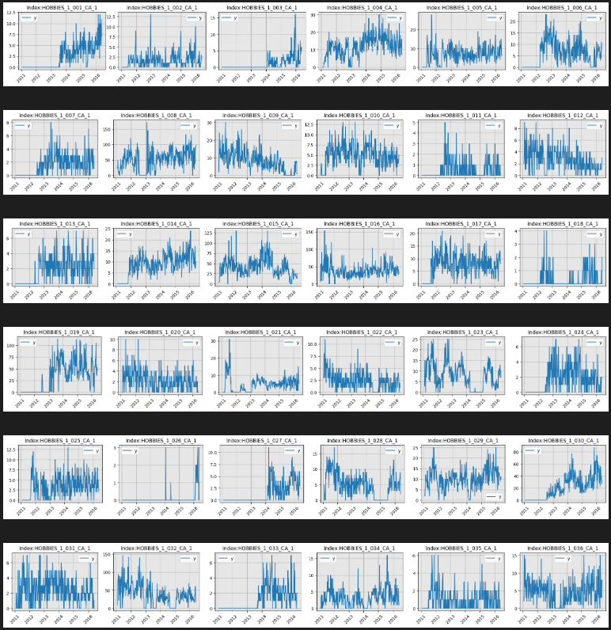
Why do we Consider Forecasting Models?
Quick answer: Quick and effective assistance in our Decision Making.
Example: Inventory Replenishment
A bit longer answer:
Assist managers and developers be more agile and strategic in their decisions
Every human creates 1.7MB of data every second
How many can the human brain process?

Slide 5
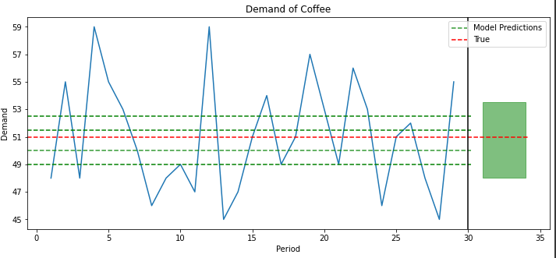
How to Pick a Model?
Okay Fil, but how do we pick a model?
Lets assume we forecast the demand for coffee!
We assume demand is independent of weather/price/location
Constant demand with mean = 51 with some noise
We generate predictions using different models
But we get high forecast uncertainty
Model selection uncertainty
Parametric uncertainty
Forecast uncertainty originated from noise

Slide 6
Forecast combinations
In every forecasting problem we look for a “good-enough” model.
A non trivial and usually difficult task
Let's avoid it!
Forecast Combinations
Instead of looking for the “best-model”, combine diverse predictions
Simple combinations show accuracy benefits
How to get diverse predictions?
Very bad forecasts will harm the combined predictions
Kourentzes, Nikolaos & Barrow, Devon & Petropoulos, Fotios. (2018). Another look at forecast selection and combination: Evidence from forecast pooling. International Journal of Production Economics. 209. 10.1016/j.ijpe.2018.05.019.

Slide 7
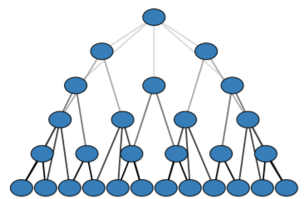
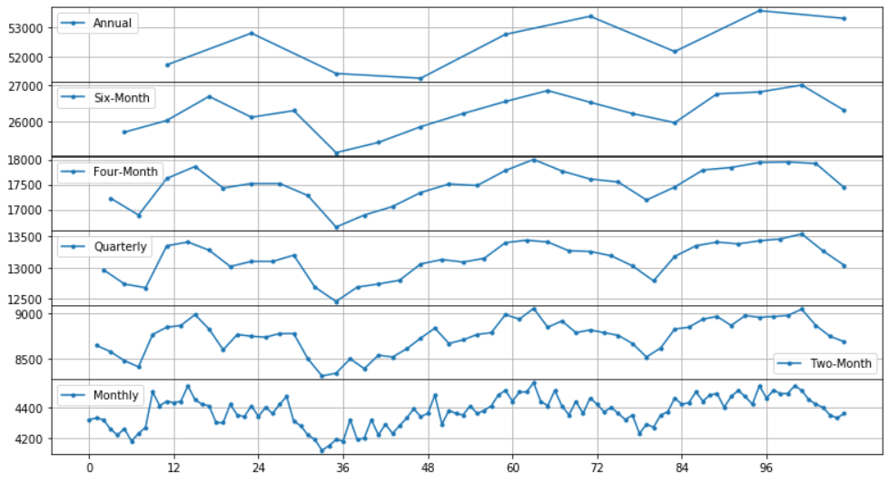
Introduction to Temporal Hierarchies
How to get diverse predictions?
Change your viewpoint through Temporal Aggregations
Temporal Aggregations:
Filter high frequency components (seasonality)
Boost low frequency ones(trend)
Reveal hidden structural information on intermittent levels

Slide 8
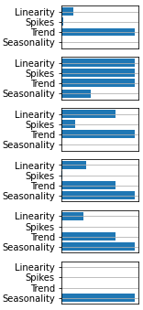
Introduction to Temporal Hierarchies
How to get diverse predictions?
Change your viewpoint through Temporal Aggregations
The Diversity Among Levels
Features are strengthen/weaken at each level
What if we combine information from each level into a single forecast?

Slide 9
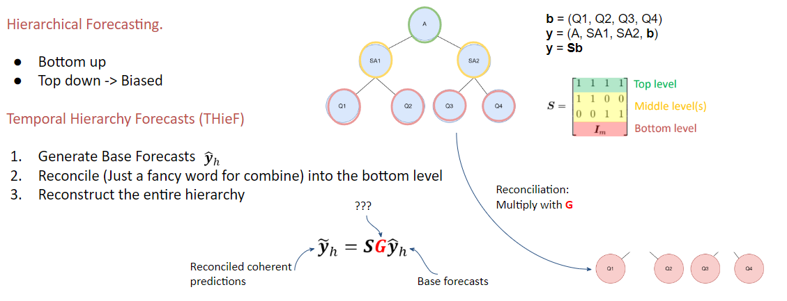
How to Forecast with Temporal Hierarchies?
Panagiotelis, A., Athanasopoulos, G., Gamakumara, P.,& Hyndman, R.J. (2021). Forecast reconciliation: A geometric view with new insights on bias correction. International Journal of Forecasting, 37, 343–359.
Athanasopoulos, George & Hyndman, Rob & Kourentzes, Nikolaos & Petropoulos, Fotios. (2017). Forecasting with Temporal Hierarchies. European Journal of Operational Research. 262. 10.1016/j.ejor.2017.02.046.

Slide 10
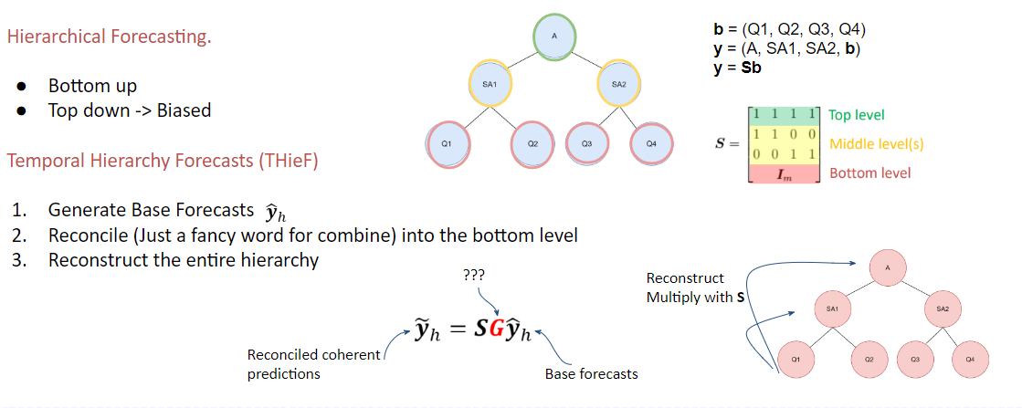
How to Forecast with Temporal Hierarchies?
Panagiotelis, A., Athanasopoulos, G., Gamakumara, P.,& Hyndman, R.J. (2021). Forecast reconciliation: A geometric view with new insights on bias correction. International Journal of Forecasting, 37, 343–359.
Athanasopoulos, George & Hyndman, Rob & Kourentzes, Nikolaos & Petropoulos, Fotios. (2017). Forecasting with Temporal Hierarchies. European Journal of Operational Research. 262. 10.1016/j.ejor.2017.02.046.

Slide 11

Estimate G
Analytical Methods:
Wh is the positive definite covariance matrix of base forecast errors.
Problem: Estimating Wh in practise is very challenging.
Solution: Again, avoid the problem and rely on approximations
Two diagonal estimators which will be useful later:
Structural Scaling: A diagonal matrix containing the number of errors contributing to each level.
Variance Scaling: A diagonal matrix with the in-sample one-step-ahead error variance of each level.
Shanika L. Wickramasuriya, George Athanasopoulos & Rob J. Hyndman (2019) Optimal Forecast Reconciliation for Hierarchical and Grouped Time Series Through Trace Minimization, Journal of the American Statistical Association, 114:526, 804-819
Athanasopoulos, George & Hyndman, Rob & Kourentzes, Nikolaos & Petropoulos, Fotios (2017). Forecasting with Temporal Hierarchies. European Journal of Operational Research. 262. 10.1016/j.ejor.2017.02.046

Slide 12
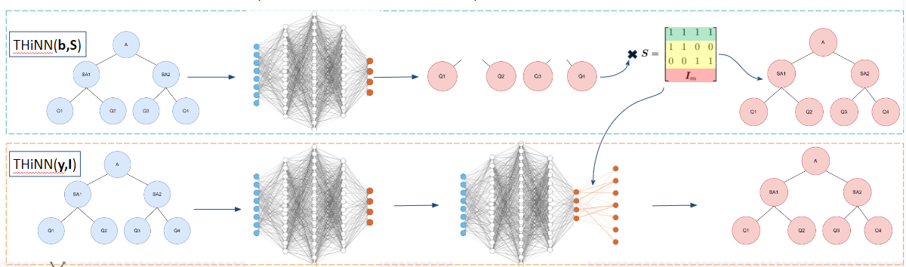
Estimate G
Approximate G with Temporal Hierarchy Neural Network (THiNN)
NNs: Non-Linear function approximators with success in numerous tasks
Relax classical restrictions
Preference over classical ML (Gradient Boosted Decision Trees) due to architectural freedom.
Theodosiou, Filotas & Kourentzes, Nikolas. (2021) Forecasting with Deep Temporal Hierarchies. SSRN Scholarly Paper ID 3918315. Social Science Research

Slide 13
Wrap up!
We need to find a way to deal with model selection!
Forecast combinations is the go-to in the forecasting world!
We use different viewpoints to produce different features
THieF’s success is based on combining diverse information
Reconciliation is a very “hot” field in forecasting!!
We talked about analytical methods!
We talked about Neural Network methods!

Slide 14
The end ☺
Questions?
Filotas Theodosiou
Contact Details:
- filotas.Theodosiou@vives.be
- www.linkedin.com/in/filotas-theodosiou

